Slide 1
Microsoft Azure Cloud Usage

Slide 2
Agenda
Introduction of myself, and our group Wankuma Alliance
Review of what “cloud” is.
Why I chose Azure as my topic.
How Azure is actually used in business; Example of my previous work.

Slide 3
INTRODUCTION

Slide 4
Self Introduction
Name: Tomoya Yamanaka
Nationality : Japan
Language: Japanese, English… and a little Chinese and Tagalog
Hobby: Attending/Doing Free IT Seminar
Work: IT Consultant
Certification: Microsoft Certified Trainer
Position: Founder of YASC, INC
Wankuma Alliance Manila director

Slide 5
About Wankuma Alliance
Wankuma Alliance is a Japanese free IT seminar group which have already held over 200 seminars in more than 10 years.
Home Page(Japanese):
http://wankuma.com/
YouTube:
https://www.youtube.com/channel/UC_6s2HNcKjray21gTKVCYQw
Facebook(Philippines):
https://www.facebook.com/groups/WankumaAlliancePh/

Slide 6

About Wankuma
Wan-わん- is “bowwow” by dog in Japanese.
Kuma-くま- is “bear” in Japanese.
The 2 founder of Wankuma Alliance named it with almost joking, but the activity became quite long

Slide 7
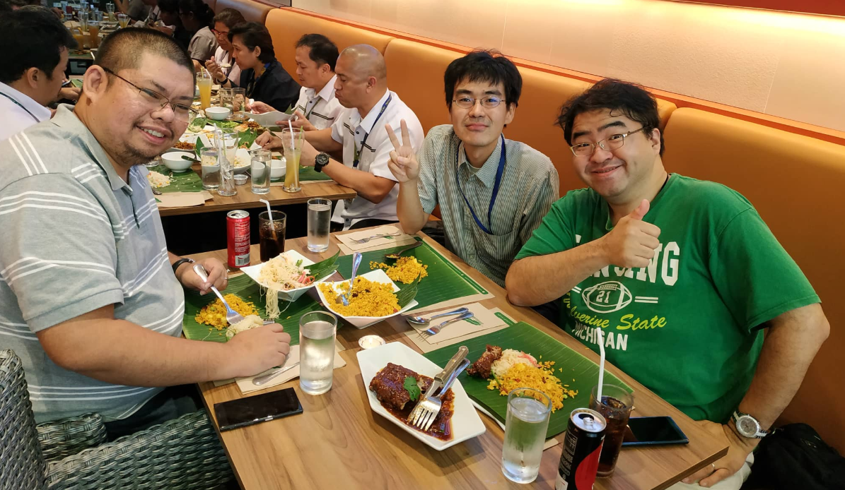
The founder of Wankuma Alliance
Founder:
Hirotoshi Naka
Big Man!

Slide 8
If you prefer Filipino group
There are many other IT groups now a days.
Following group PHINUG is my recommendation.
PHINUG(PHilippines .Net User Group) Facebook:
https://www.facebook.com/groups/phinug/
Organizer:
Jon
Limjap
Nice Guy!

Slide 9
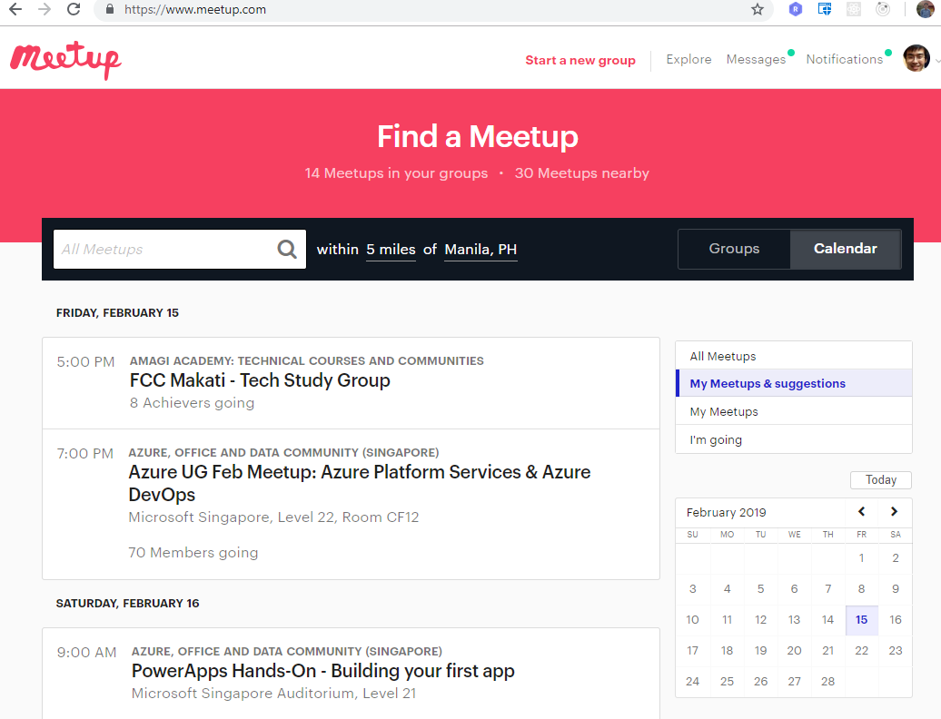
If you prefer Filipino group
You can find other groups with
https://www.meetup.com/

Slide 10
Any question so far?
Is there someone who wants to take a picture of a previous page?

Slide 11
Review About cloud

Slide 12
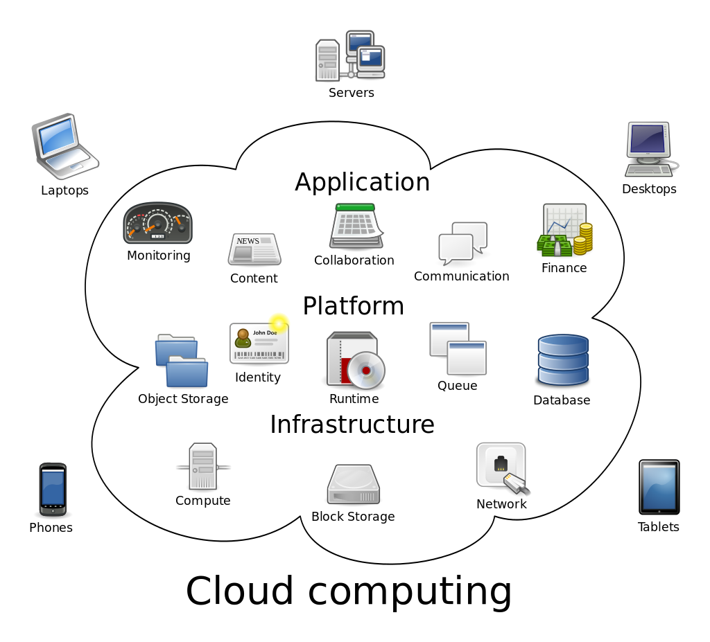
What’s Cloud?
My rough explanation:
Data center rental server services nowadays.
Opposite word is On-Premise (local machines).
https://en.wikipedia.org/wiki/Cloud_computing

Slide 13
What case Cloud is good?
It’s especially good for testing purposes
We can do quick start and quick bye-bye
I have new idea.
I wanna try
On-Premise:
Need to buy machines
Need to place the machines.
and so on…
Time consuming and costing!
Cloud:
Need an cloud account
Need to apply some operation on cloud portal or console
Done!
Much faster than on premise and easy to delete also.

Slide 14
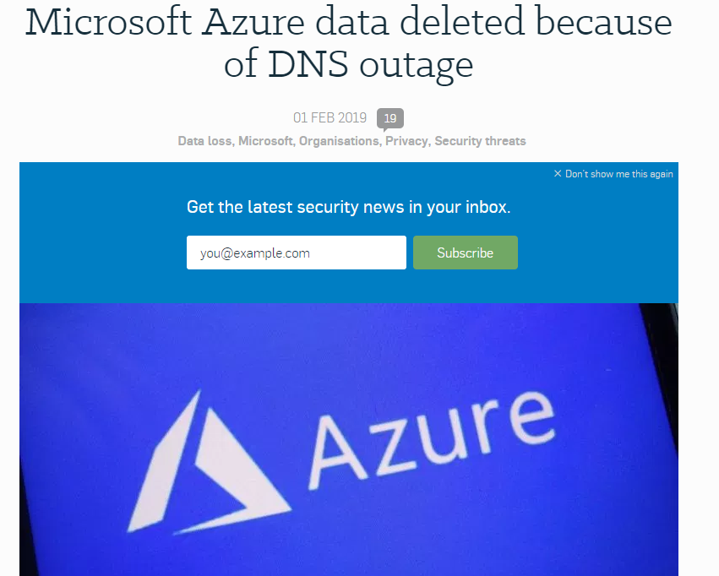
Should we use Cloud all time?
Cloud is a data center service so that if you don’t want data center trouble, you should still use On-Premise machines.
https://nakedsecurity.sophos.com/2019/02/01/dns-outage-turns-tables-on-azure-database-users/

Slide 15
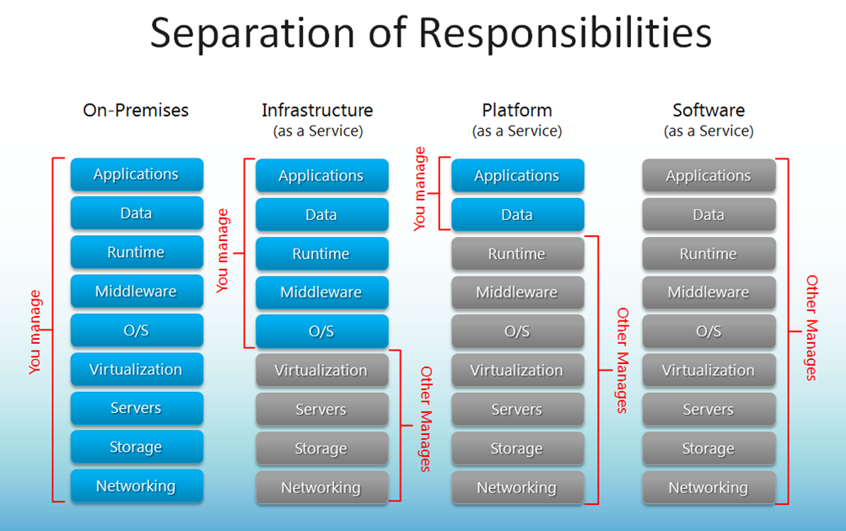
Should we use Cloud all time?
https://blogs.technet.microsoft.com/kevinremde/2011/04/03/saas-paas-and-iaas-oh-my-cloudy-april-part-3/

Slide 16
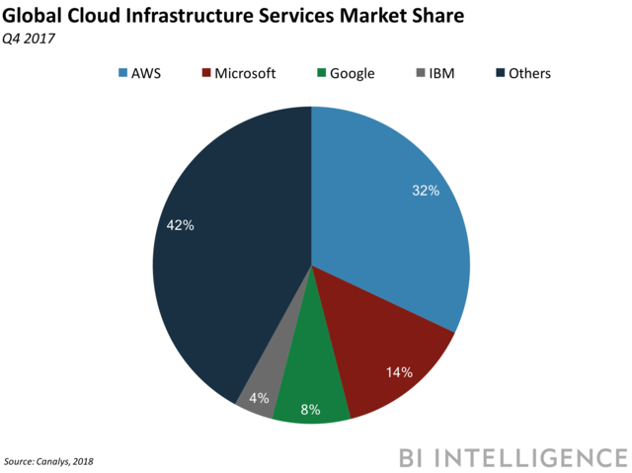
What are the Major Cloud?
AWS by Amazon
Azure by Microsoft
Google Cloud
by Google
And so on…
※AWS is the most popular because it’s the world first cloud
and the service price is cheapest in most cases.
https://www.businessinsider.com/global-cloud-market-q4-2018-2

Slide 17
That’s all from me for reviewing cloud knowledge.
Is there someone who wants to add more?

Slide 18
WHY Azure?

Slide 19
Why Azure?
-Azure is No.2 share cloud provided by Microsoft.
(Good Position)
-Because of Microsoft, there are lots of …
Documents, especially for developers.
Relatively reasonable service fee for MS products, such as Windows Server.
Dev Tool Supports, such as Visual Studio
Big Community and User Supports
※Microsoft Certified Trainer has provided subscriptions

Slide 20
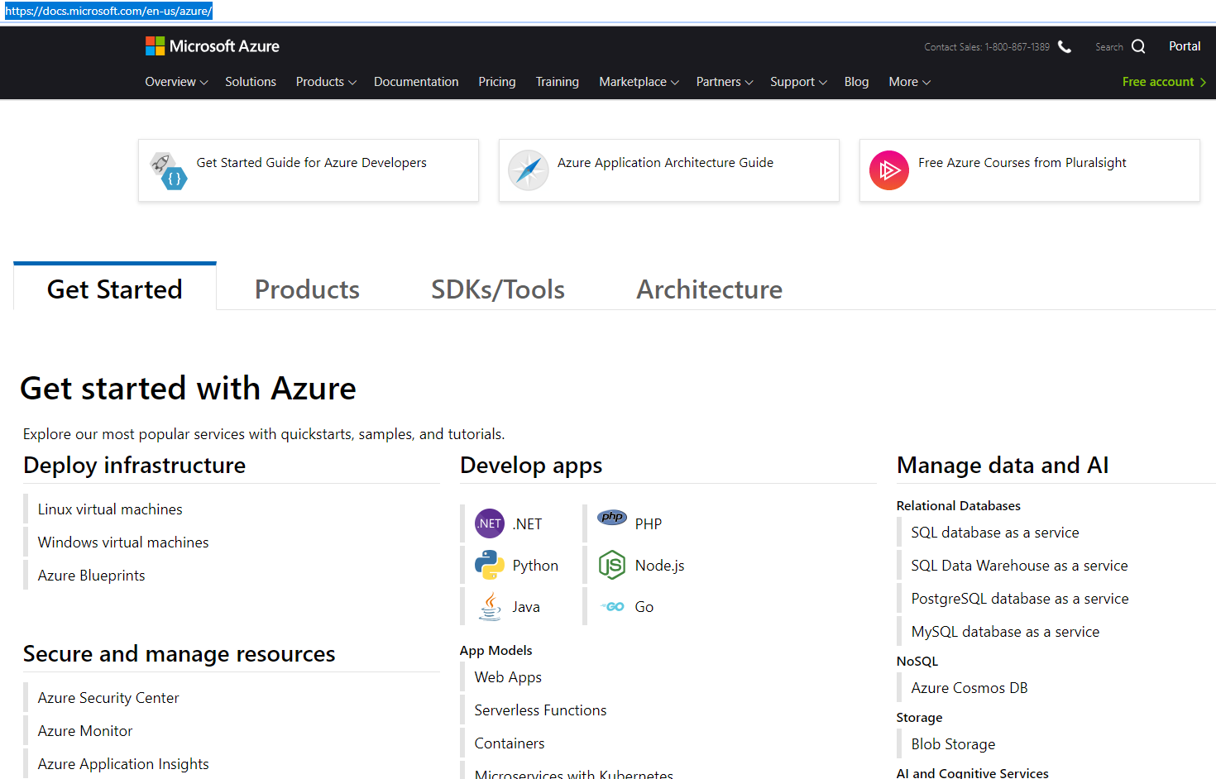
About Azure Documents
https://docs.microsoft.com/en-us/azure/

Slide 21
About Azure Documents
This is my favorite
https://docs.microsoft.com/en-us/azure/

Slide 22
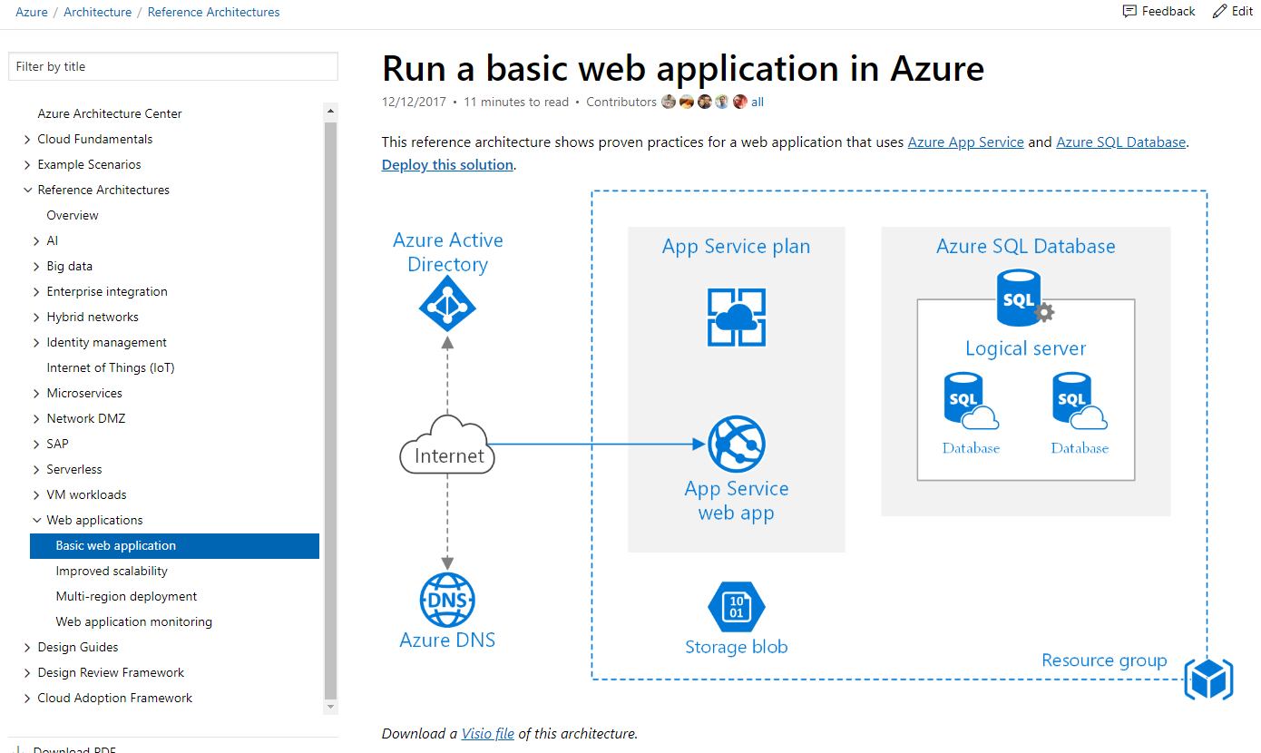
About Azure Documents: Web App Ref. Architecture
https://docs.microsoft.com/en-us/azure/architecture/reference-architectures/app-service-web-app/basic-web-app

Slide 23
Microservices
Lots of cloud services are made and connected to each other. This style design is called as Microservices.
It’s current trend of cloud.
https://docs.microsoft.com/en-us/azure/architecture/reference-architectures/app-service-web-app/basic-web-app

Slide 24
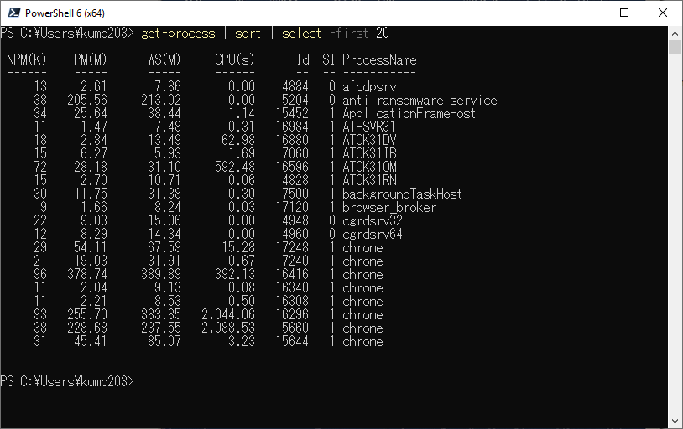
Microservices
The idea is same as command line piping.
1st cmdlet get-process’s output is piped to 2nd cmdlet sort and its output is piped to 3rd cmdlet select.
And then the result is the output.

Slide 25
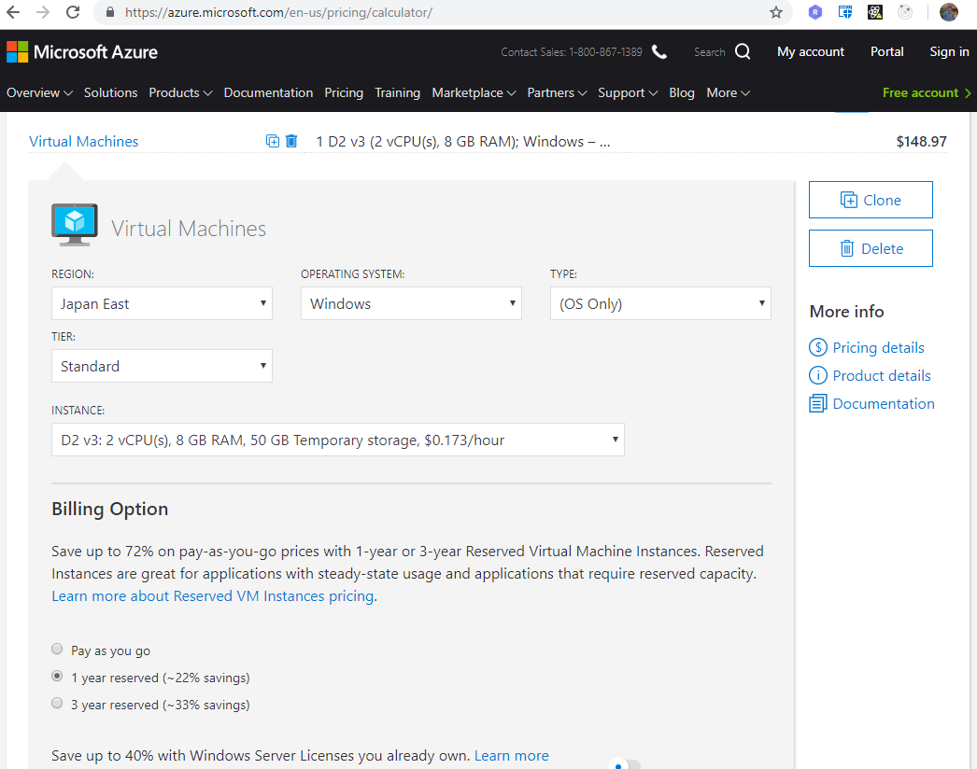
About Azure Price
https://azure.microsoft.com/en-us/pricing/calculator/

Slide 26
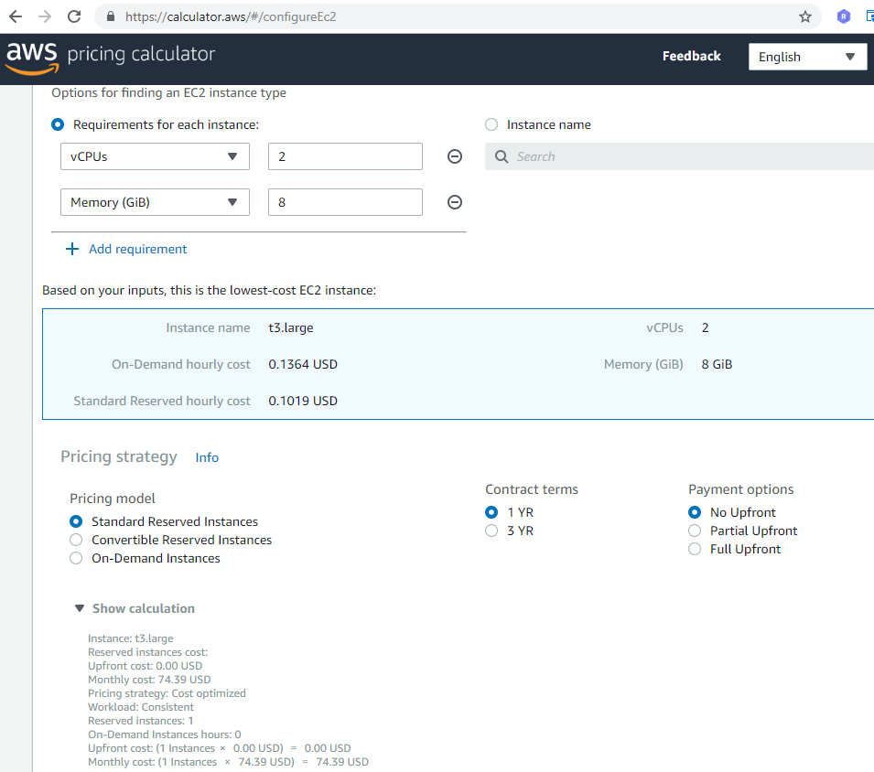
About AWS Price
https://calculator.aws

Slide 27
Azure Price vs. AWS Price
Azure(Japan East) Example:
AWS(Japan East) Example:
VM(2CPU8GB) $126.57
Storage(SSD) $ 22.40
☆Sub-Total $148.97
VM(2CPU8GB) $74.39
Storage(SSD) $ 3.60
☆Sub-Total $77.99

Slide 28
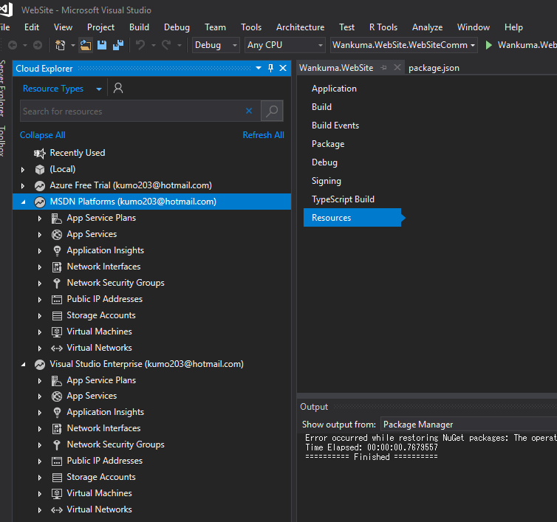
Visual Studio Support
The most popular IDE Visual Studio provides its default integrated Azure support.

Slide 29
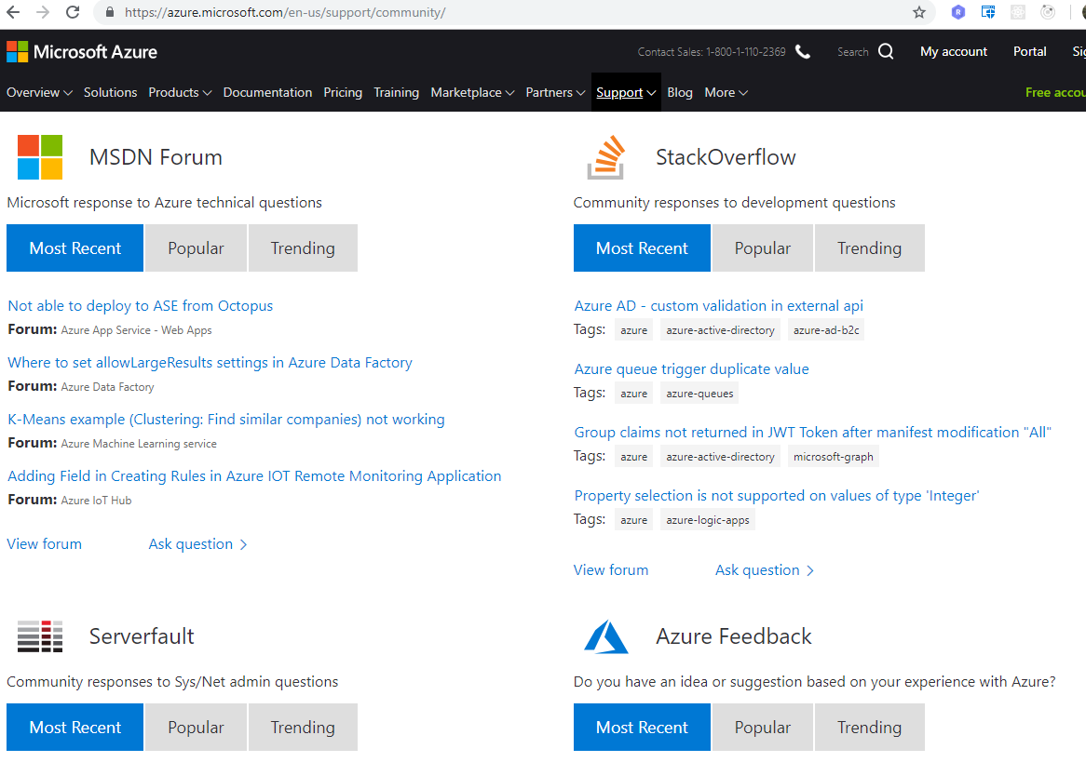
Community Support
https://azure.microsoft.com/en-us/support/community/

Slide 30
Those are the reasons why I like Azure.
At least it’s good one in many.

Slide 31
Example in actual business

Slide 32
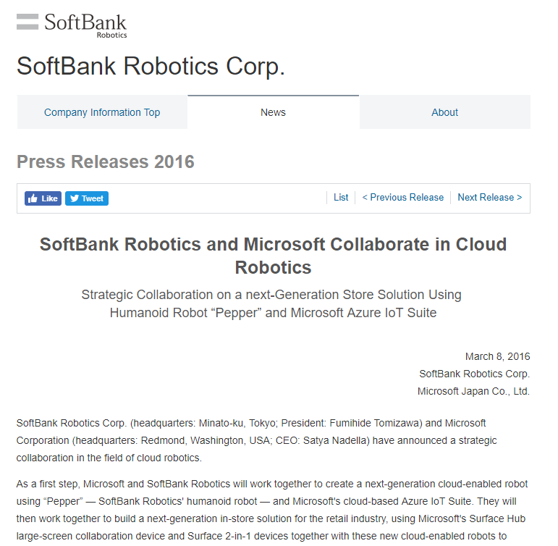
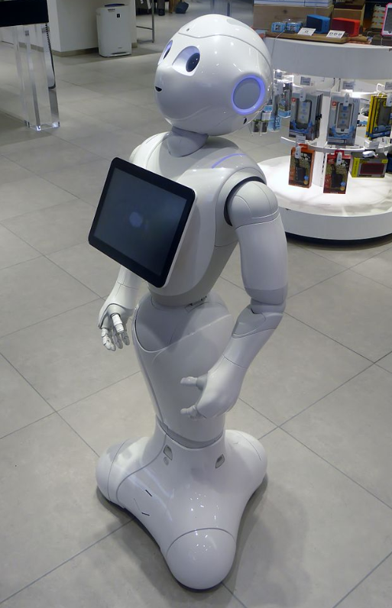
IoT data collecting system with Azure
https://www.softbank.jp/en/corp/group/sbr/news/press/2016/20160308_01/
https://en.wikipedia.org/wiki/Pepper_(robot)

Slide 33
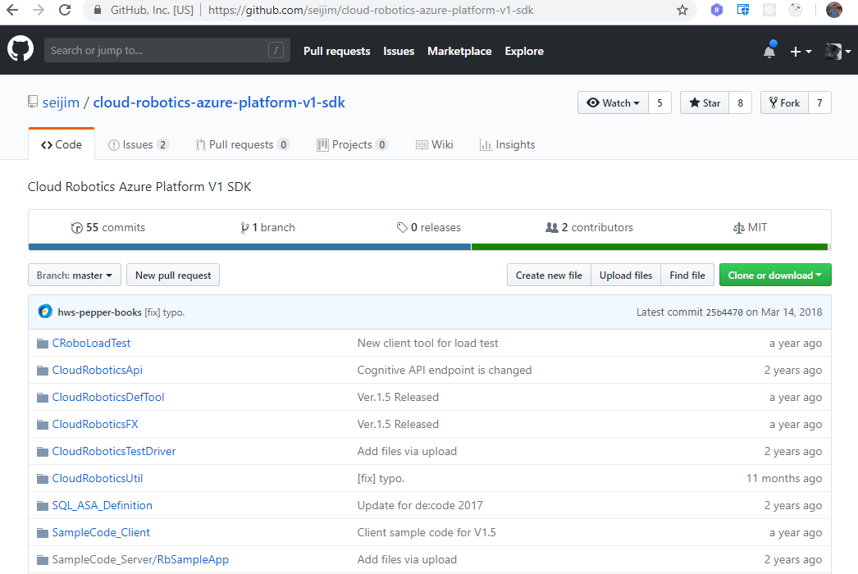
Cloud Robotics Azure Platform
https://github.com/seijim/cloud-robotics-azure-platform-v1-sdk

Slide 34
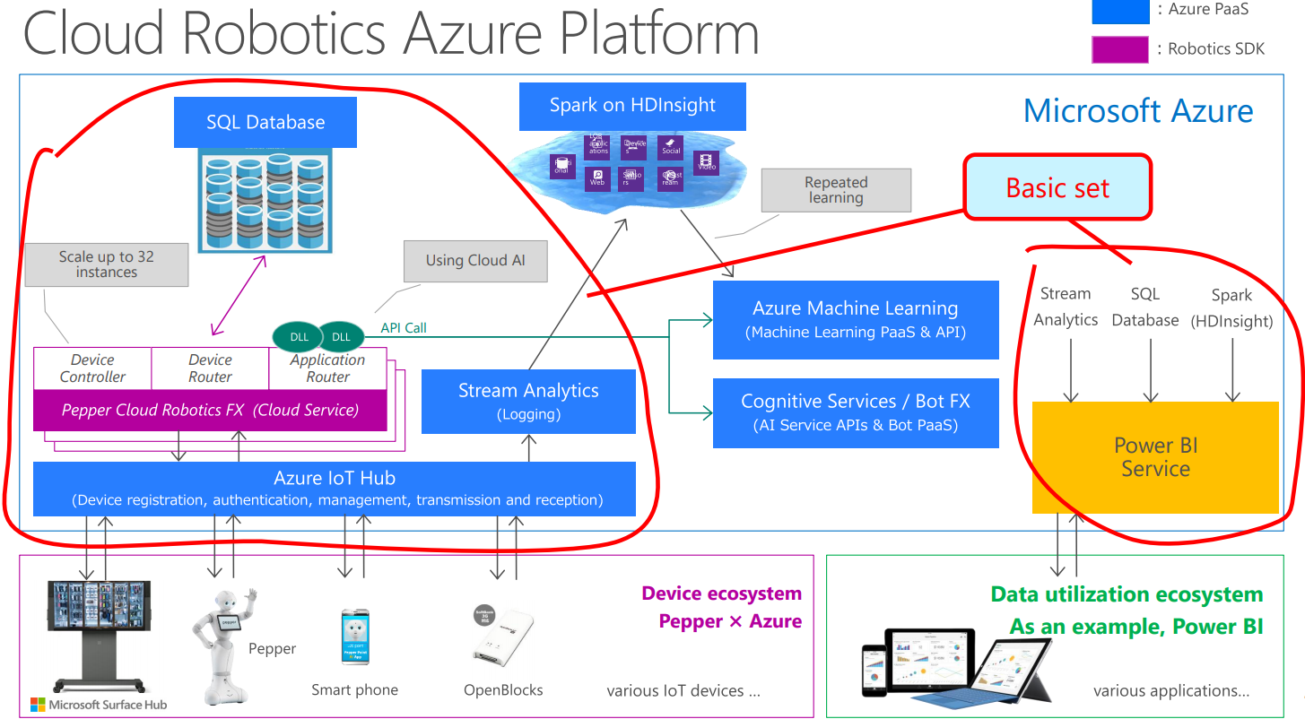
Cloud Robotics Azure Platform
https://github.com/seijim/cloud-robotics-azure-platform-v1-sdk

Slide 35
Cloud Robotics Azure Platform
Microservices architecture to compose the service.
https://github.com/seijim/cloud-robotics-azure-platform-v1-sdk

Slide 36
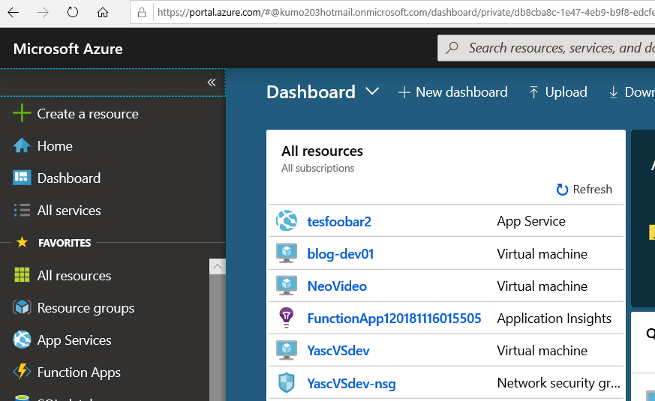
Normal Way: Azure Portal
Because of Microservices architecture, the system has lots of services. It takes time make the services in Azure normal way, Azure Portal.
https://portal.azure.com/

Slide 37
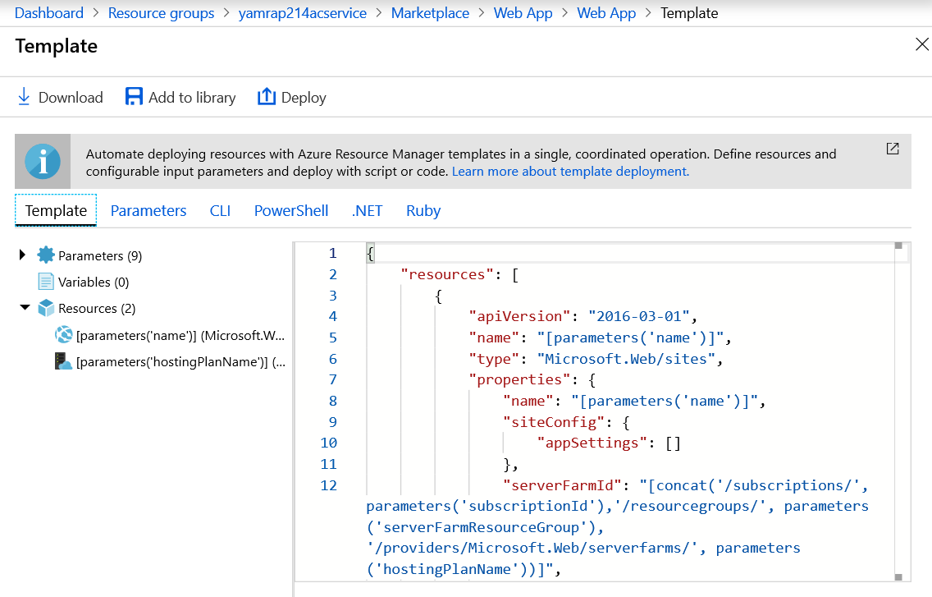
Batch Way
For such case, there are ways to make services from scripts, such as Powershell, Ruby and so on.

Slide 38
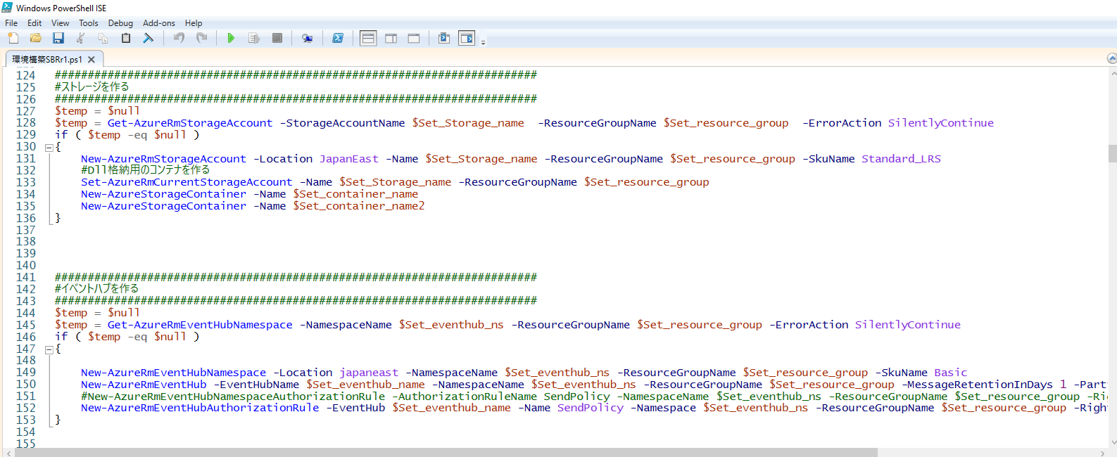
Batch Way:Azure Powershell
We used Powershell for our project.

Slide 39
That’s the actual usage we did in our business project.
Any question about it?

Slide 40
Conclusion
Today, I explained about Azure.
Azure is one example of cloud, and cloud is one field, where the innovations are happening most often.
When you use it, you need to keep tracking its updates.
Thus, Good Luck!!

